Slide 1


Slide 2
Airbnb Market Analysis: Unlocking Insights with EDA and Power BI
Objective
To analyze Airbnb operations in Chicago and New Orleans through a blend of Exploratory Data Analysis (EDA) and interactive Power BI dashboards. This project offers a deep dive into market trends, pricing strategies, property characteristics, and host dynamics, empowering stakeholders with actionable insights.
Skills Utilized:
Data Cleaning & Preparation: Addressed data quality issues using Python and Power BI Prep.
Data Transformation: Generated derived metrics and categories for enhanced Visualisation and clarity.
Dashboard Development: Designed dynamic, interactive dashboards with DAX measures, calculated columns, and slicers for seamless exploration.
Insightful Visualisation: Segmented findings into Overview, Property Analysis, Pricing Analysis, and Host Analysis to ensure a structured narrative.
Tools Mastery: Power BI, Python , Data Wrangling, and Advanced Visual Analytics.

Slide 3
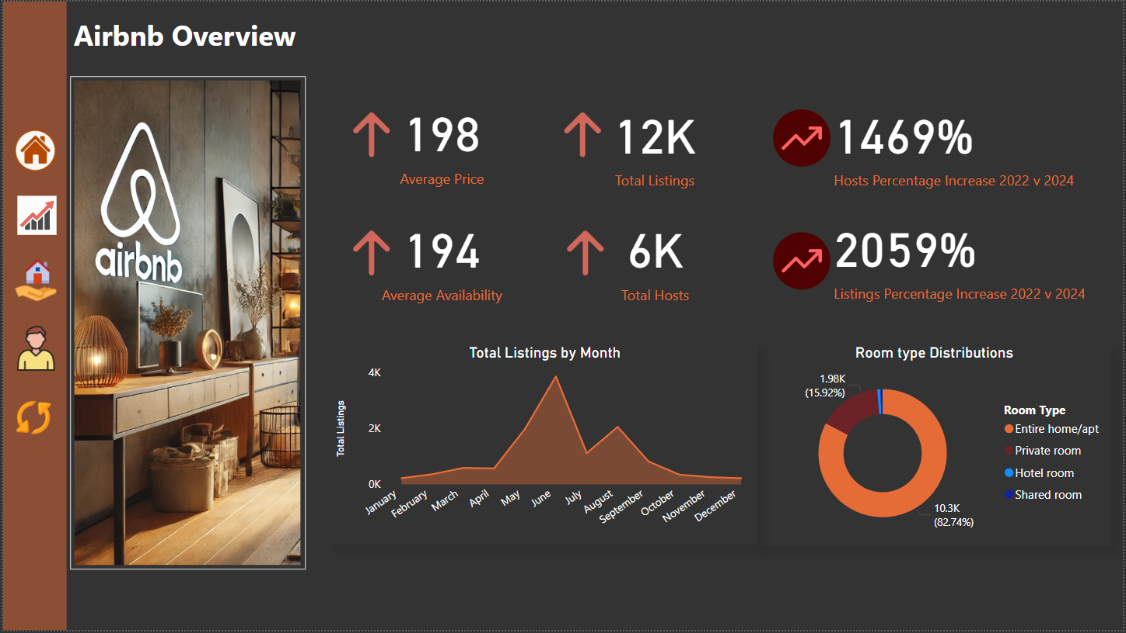

Slide 4
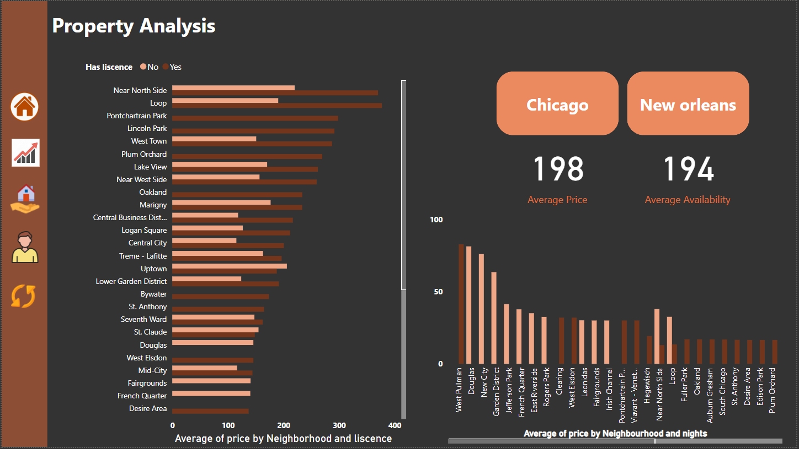

Slide 5
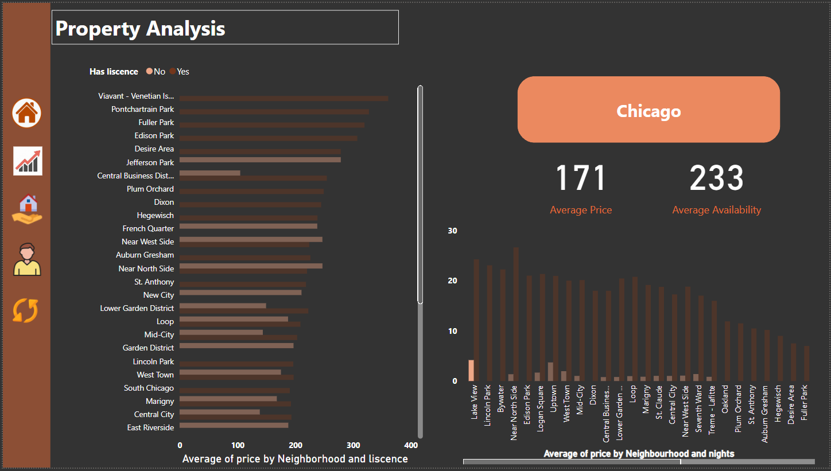

Slide 6
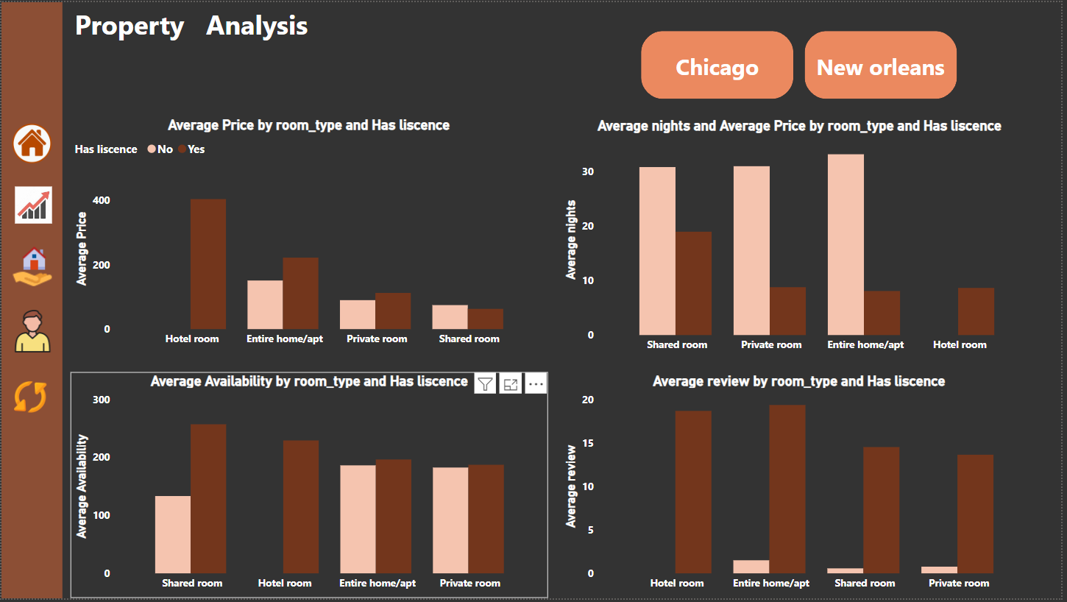

Slide 7
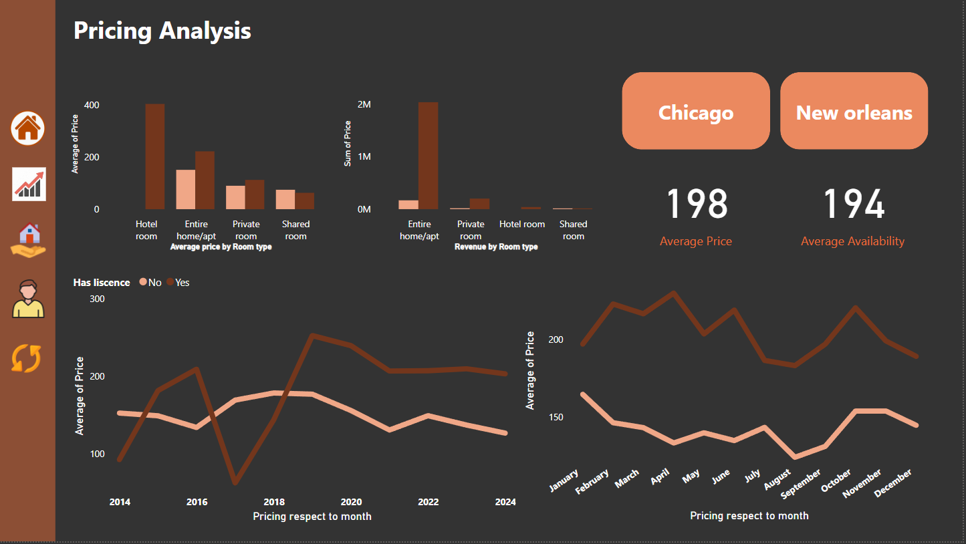

Slide 8
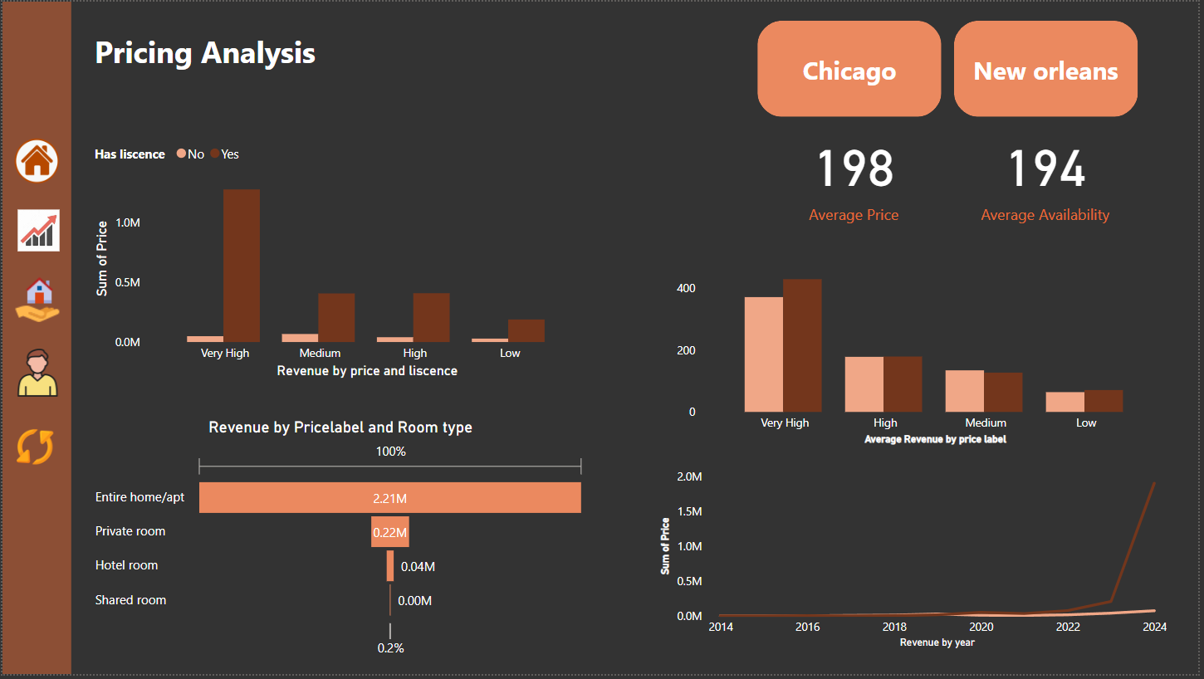

Slide 9
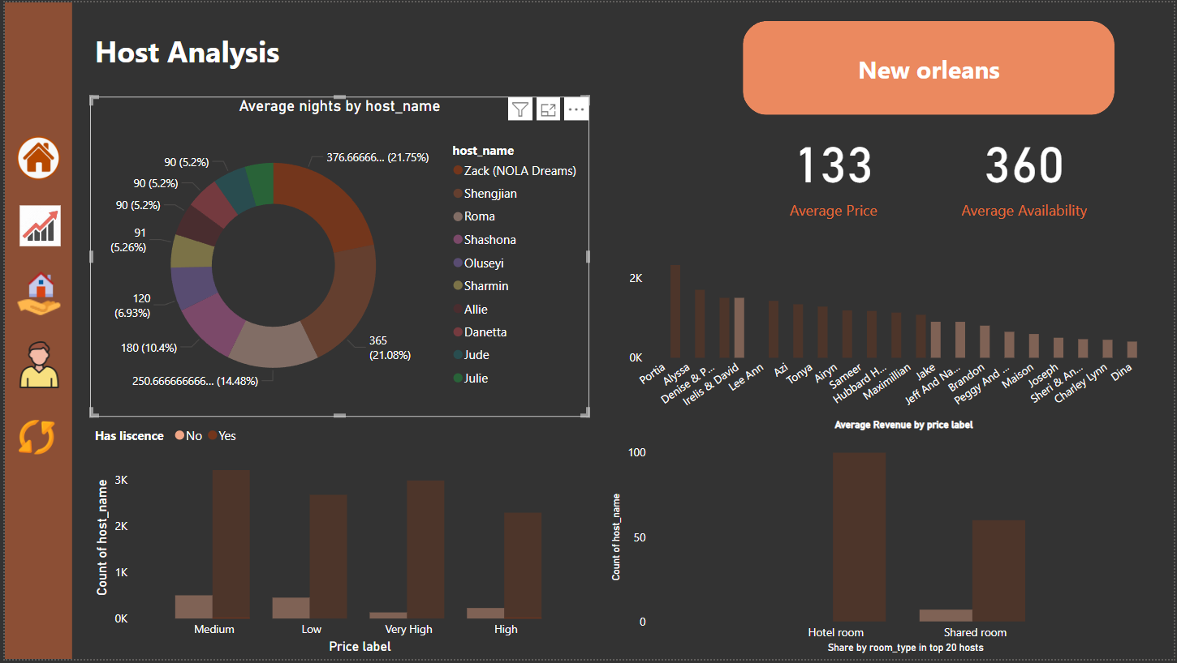

Slide 10
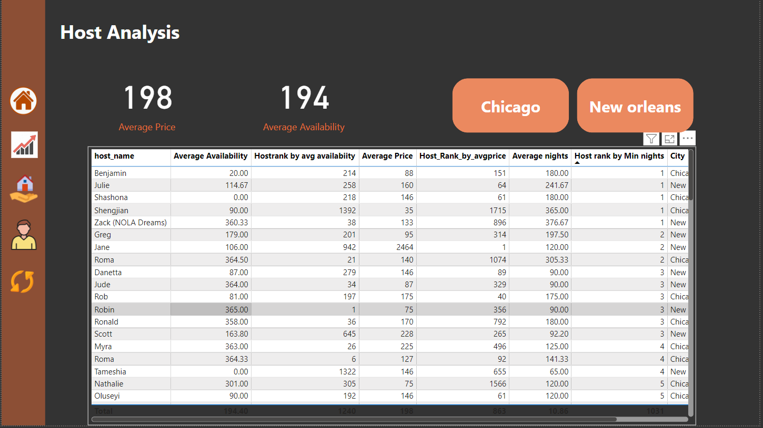

Slide 11
Airbnb Overview Analysis
Observations
The average price of a room across the two cities is $198, with an average availability of 194 days per year.
There are approximately 6,000 hosts managing a total of 12,000 listings, indicating that each host manages an average of two listings.
When comparing the growth in these cities to 2022, there has been remarkable growth in the Airbnb market
1469% increase in hosts from 2022 to 2024.
2059% increase in listings during the same period.
This explosive growth highlights the substantial potential of the Airbnb hosting market in these cities.
Room Type Distribution
Entire homes dominate the market, comprising 82% of the total listings.
Shared rooms represent the smallest share, with only 0.54% of the market.
Seasonal Trends in Listings
Listings typically start at their lowest in January and remain stagnant until April.
A sharp increase is observed in May and June, with June experiencing the highest listing count of the year.
A decline follows in July, with another small spike in August.
From September onward, listings gradually decrease, hitting their lowest point in December.

Slide 12
Airbnb Overview Analysis
Recommendations
Market Targeting and Promotions
Focus marketing efforts on the period from May to June, as this is the peak listing season. Encourage hosts to list during this period to capitalize on higher demand.
Provide incentives for hosts during off-peak months (January to April and September to December) to maintain steady listing availability throughout the year.
Host Retention and Expansion
Leverage the significant growth in hosts and listings by offering training and support programs to new hosts to ensure high-quality accommodations.
Highlight the potential revenue from managing multiple listings to attract more hosts.
Room Type Strategy
Since entire homes dominate the market, ensure targeted promotions for this segment.
Investigate ways to improve the appeal of shared rooms, such as better amenities or pricing strategies, to diversify the room types offered.
Seasonal Demand Management
Use dynamic pricing strategies to adjust room rates during off-peak months to attract more bookings and maximize host revenue.
Encourage long-term stays during off-peak months to improve room occupancy rates.

Slide 13
Property Analysis
Observations
Neighborhood Pricing and Licensing:
Licensed Hosts: Neighborhoods with licensed hosts tend to have a higher average price compared to those without a license.
Unlicensed Hosts: In neighborhoods without licensed hosts, the average price is lower, but the average number of nights spent is higher, with the exception of West Pullman.
City-wise Analysis:
Chicago:
Licensed neighborhoods in Chicago have higher average prices than unlicensed neighborhoods.
Average nights spent in unlicensed neighborhoods exceed those in licensed ones, again excluding West Pullman.
The average price and availability for licensed neighborhoods in Chicago are $214 and 201 days, respectively.
New Orleans:
Similar trends are observed, with higher average prices in licensed neighborhoods and more nights spent in unlicensed ones.
However, New Orleans shows a slight decline compared to Chicago, with an average price of $181 and average availability of 187 days.

Slide 14
Property Analysis
Recommendations
Encourage Licensing Among Hosts:
Since licensed hosts charge higher prices, cities should promote licensing by offering incentives, such as reduced fees or faster processing times for new applications.
Educate hosts on the benefits of licensing, including increased trust from guests and higher potential earnings.
Address Night-Stay Trends:
Investigate why guests prefer unlicensed neighborhoods for longer stays and replicate these factors in licensed areas, such as affordability, location convenience, or unique experiences.
City-Specific Action Plans:
Chicago: Focus on maintaining its higher pricing trend while improving occupancy in neighborhoods with lower availability.
New Orleans: Work on narrowing the gap between licensed and unlicensed host performance by addressing price sensitivity and availability issues.

Slide 15
Property Analysis
Observations
Average Availability:
Chicago:
In Chicago, neighborhoods with non-licensed hosts have higher average availability per year compared to licensed hosts.
New Orleans:
In New Orleans, neighborhoods with licensed hosts typically have higher average availability, unlike Chicago.
Average Reviews:
Chicago:
neighborhoods with Licensed hosts in Chicago have significantly higher average reviews compared to non-licensed hosts.
New Orleans:
Similar to Chicago, licensed hosts in New Orleans receive substantially more reviews on average than non-licensed hosts.

Slide 16
Property Analysis by Room Type- Chicago
Observations
Average Price by Room Type:
Hotel Rooms have the highest average price at $403, followed by entire homes, private rooms, and shared rooms.
In every room type, licensed hosts charge more on average compared to non-licensed hosts. For example:
Shared Rooms: Licensed - $52, Non-Licensed - $36.
Hotel Rooms: All licensed hosts - $403.
Average Nights Stayed:
Non-licensed hosts have higher average nights stayed across all room types.
Shared rooms under non-licensed hosts have the highest average nights stayed, highlighting a preference for affordability in this segment.
Average Availability:
Shared Rooms have the highest average availability, with licensed shared rooms showing nearly double the availability of non-licensed shared rooms.
Average Reviews:
Entire Homes dominate in terms of average reviews compared to other room types.
However, the ratio of reviews between licensed and non-licensed hosts is stark:
Licensed Entire Homes - 20 reviews on average.
Non-Licensed Entire Homes - 2 reviews on average.

Slide 17
Property Analysis by Room Type- Chicago
Recommendations
The stark difference in pricing and reviews suggests significant advantages for licensed hosts.
Create awareness campaigns showcasing how licensing leads to higher revenue and better guest engagement.
Simplify the licensing process and offer support to encourage compliance.
Work with hosts of licensed shared rooms to ensure their higher availability is matched with consistent quality and competitive pricing to attract more guests.
Shared rooms have high availability and attract long stays due to affordability.
Market this category to budget-conscious travelers and students to boost bookings.
For licensed shared rooms, emphasize the added value and quality to justify the higher price.
Work with hosts of licensed shared rooms to ensure their higher availability is matched with consistent quality and competitive pricing to attract more guests.

Slide 18
Property Analysis by Room Type-New Orleans
Observations
Average Price by Room Type:
Similar to Chicago, hotel rooms have the highest average price among all room types.
Licensed hosts consistently charge higher average prices compared to non-licensed hosts across all room types.
Shared rooms (non-licensed) have the lowest average price among all categories
Average Nights Stayed:
Non-licensed entire homes have the highest average nights stayed at 32 nights, whereas licensed entire homes have the lowest average at 8 nights.
Among licensed hosts, shared rooms have the highest average nights at 18 nights.
Average Reviews:
Across all room types, licensed hosts receive an average of 5 times more reviews than non-licensed hosts, indicating better guest engagement and satisfaction.

Slide 19
Property Analysis by Room Type-New Orleans
Recommendations
Optimize Pricing Strategies:
Licensed Hosts:
Highlight the value and quality of licensed properties to justify higher pricing.
Use dynamic pricing tools to remain competitive, especially for lower-demand periods or room types like licensed shared rooms.
Non-Licensed Hosts:
Encourage non-licensed hosts to align pricing with market expectations while maintaining affordability to attract budget-conscious travelers.
Improve Performance of Non-Licensed Hosts:
Train non-licensed hosts to improve guest experiences, aiming to reduce the review gap between licensed and non-licensed hosts.
Promote the benefits of obtaining a license, such as higher trust, better reviews, and potentially increased revenue.
Focus on Shared Rooms:
Licensed shared rooms show higher average nights (18 nights) compared to other licensed room types. Market this category as a mid-range option for travelers looking for affordability combined with quality.
Non-licensed shared rooms with low pricing can be positioned for budget travelers, but efforts should be made to improve quality and guest satisfaction.
Promote Entire Homes:
With the highest average nights among non-licensed listings, entire homes should be marketed as ideal options for longer stays.
Provide promotional offers to licensed hosts of entire homes to compete with non-licensed properties in terms of stay duration.

Slide 20
Pricing Analysis
Chicago:
The average price by room type is highest for hotel rooms, particularly those that are licensed,
and lowest for shared rooms.
Despite this, the most revenue is generated from entire home/apartment room types, especially licensed ones, which earn 4–5 times more revenue compared to other room types.
Pricing Trends:
Licensed properties consistently have higher average prices compared to non-licensed ones, whether analyzed by year or month.
The average price peaks in July, reflecting a seasonal trend.
New Orleans:
Similar to Chicago, the average price is typically higher for licensed properties across all room types, and the entire home/apartment type generates the most revenue.
However, unlike Chicago, there is a notable spike in average prices in October, highlighting a unique seasonal trend in this city.

Slide 21
Host Analysis
Observations
Chicago:
In terms of average nights per host, the top three hosts where most guests stay are Shengjian, Roma, and Ronald.
The average price tends to be higher for licensed hosts, with Tonya Portia standing out.
For price labels, the high price label dominates in count, indicating a significant number of hosts with higher average prices.
Interestingly, among the top 20 hosts, 8 out of 20 are unlicensed, highlighting the prevalence of unlicensed properties in the upper ranks.
New Orleans:
The most average nights spent per host is with Zack.
In terms of price labels, the medium price label leads in host count for licensed properties, followed by the low price label.
When analyzed by room type, hotel room type ranks highest among the top 20 hosts.

Slide 22
Host Analysis
Recommendations for Chicago:
Focus on Licensed Properties:
Since licensed properties, especially those with entire home/apartment room types, generate the highest revenue, encourage hosts to obtain licensing to improve trust and attract premium customers.
Promote hotel rooms for their higher average pricing potential to cater to high-end travelers.
Highlight Top Hosts:
Leverage the popularity of hosts like Shengjian, Roma, and Ronald by showcasing their listings in marketing campaigns to attract more bookings.
Conduct training or provide resources to other hosts to replicate the strategies of successful hosts, such as Tonya Portia, who achieve higher prices.
Seasonal Pricing Strategies:
With average prices peaking in July, recommend hosts increase prices during this time to maximize revenue.
Offer promotional discounts during off-peak months to attract budget-conscious travelers.
Regulate Unlicensed Hosts:
Encourage unlicensed hosts to obtain licensing, as they make up a notable portion of the top hosts. This could improve compliance and overall service quality.

Slide 23
Host Analysis
Recommendations for New Orleans:
Capitalize on October Price Spikes:
The significant spike in average prices in October suggests a strong seasonal demand. Encourage hosts to optimize pricing strategies and list properties well in advance for this period.
Target Medium Price Label Customers:
With the medium price label dominating licensed properties, focus marketing efforts on this segment by highlighting value-for-money listings.
Expand Hotel Room Listings:
Since hotel room type tops the list among the top 20 hosts, encourage investment in this room type to cater to the demand.
Support Hosts with Training:
Hosts like Zack, who attract the most average nights, could serve as benchmarks. Share best practices to help other hosts improve guest stays and retain customers longer.

Slide 24
Final observation
1. General Market Trends
Average Metrics:
Average price: $198 across both cities.
Average availability: 194 days per year.
Each host manages an average of 2 listings (6,000 hosts and 12,000 listings).
Explosive Growth (2022–2024):
Hosts: 1469% increase.
Listings: 2059% increase.
Room Type Distribution:
Entire homes dominate with 82% of listings.
Shared rooms represent just 0.54%.

Slide 25
Final observation
. Pricing and Licensing
Licensed hosts charge consistently higher prices across all room types.
Average Prices by Room Type:
Hotel rooms: Highest at $403.
Shared rooms: Lowest at $52 (licensed) and $36 (non-licensed).
Licensed properties attract more reviews (5 times more on average).
Night-Stay Trends:
Non-licensed properties have longer average stays, particularly shared rooms and entire homes.
Seasonal Trends
Listings peak in May and June, with June being the highest.
A decline occurs in July, followed by a small spike in August.
Listings are lowest from January to April and in December.
Chicago: Average prices peak in July.
New Orleans: A major price spike in October.

Slide 26
Final observation
City-Specific Trends
Chicago:
Licensed neighborhoods have higher average prices ($214) but lower average nights spent compared to non-licensed ones, except in West Pullman.
Entire home/apartment types generate the most revenue (4–5 times more than other room types).
New Orleans:
Licensed properties have higher average prices ($181) but lower nights spent than non-licensed ones.
Similar seasonal trends to Chicago but with an October price spike.

Slide 27
Final observation
. Host Analysis
Chicago:
Popular hosts by nights stayed: Shengjian, Roma, and Ronald.
High price labels dominate in count among licensed hosts.
8 of the top 20 hosts are unlicensed.
New Orleans:
Most average nights per host: Zack.
Medium price labels dominate among licensed properties.
Hotel rooms rank highest among the top 20 hosts.

Slide 28
Final Recommendations
Licensing Strategies
Promote licensing by offering incentives like reduced fees or fast-tracked applications.
Educate hosts on benefits like higher earnings, better reviews, and guest trust.
Encourage unlicensed hosts in high-demand areas to become licensed for increased revenue potential.
Seasonal Demand Management
Focus marketing efforts on the May–June peak to attract more listings and bookings.
Offer incentives for off-peak months (January–April, September–December) to maintain steady listing availability.
Use dynamic pricing tools to optimize room rates for both peak and off-peak periods.

Slide 29
Final Recommendations
3. Room Type Optimization
Entire Homes:
Promote entire homes for long-term stays, especially among non-licensed hosts, to improve revenue.
Provide promotional offers to licensed hosts of entire homes to compete with non-licensed properties.
Shared Rooms: Highlight affordability to attract budget-conscious travelers and students.
Work with licensed hosts to ensure quality and competitive pricing for shared rooms.
Customer Targeting
Target budget-conscious travelers with shared room promotions and affordable non-licensed properties.
Use value-based marketing for licensed properties to justify higher pricing.

Slide 30
Final Recommendations
Host Engagement and Training
Share best practices from successful hosts like Shengjian, Roma, and Zack to help others improve occupancy and pricing.
Provide training programs for new hosts to maintain high-quality accommodations and guest experiences.
Encourage hosts to manage multiple listings by showcasing potential revenue opportunities.
City-Specific Action Plans
Chicago:
Maintain its higher pricing trend for licensed properties while improving occupancy rates in neighborhoods with lower availability.
Market hotel room types to high-end travelers.
New Orleans:
Leverage the October price spike by promoting listings for that period in advance.
Address price sensitivity to narrow the gap between licensed and non-licensed host performance.
Encourage more hotel room listings to cater to demand.

